Slide 1
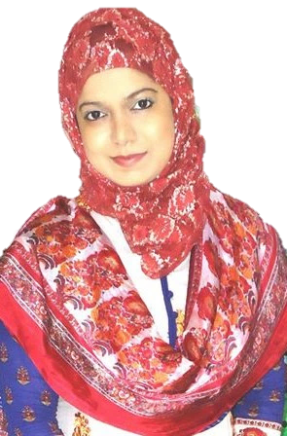


Introduction to Business (BUS 101). Lecture Delivered by: Nusrat Hafiz (NHF)

Slide 2
Discussion Agenda
Introduction to Business (BUS 101). Course Instructor: Nusrat Hafiz (NHF)
Factors of Production
Business Environment
(I) Economic and Legal Environment

Slide 3
FIVE FACTORS of PRODUCTION
Introduction to Business (BUS 101). Course Instructor: Nusrat Hafiz (NHF)
*
The Importance of Entrepreneurs to the Creation of Wealth
The factor of production is a resource that is used in the production of something else and the firm to earn economic profit.
*
LG2
Factors of Production
Land
Labor
Capital
Entrepreneurship
Knowledge
1-3

Slide 4

FIVE FACTORS of PRODUCTION
*
Introduction to Business (BUS 101). Course Instructor: Nusrat Hafiz (NHF)
The Importance of Entrepreneurs to the Creation of Wealth
*
LG2
A Video Presentation on Factor of Production: https://youtu.be/eSMVbS7BcTU
1-4

Slide 5
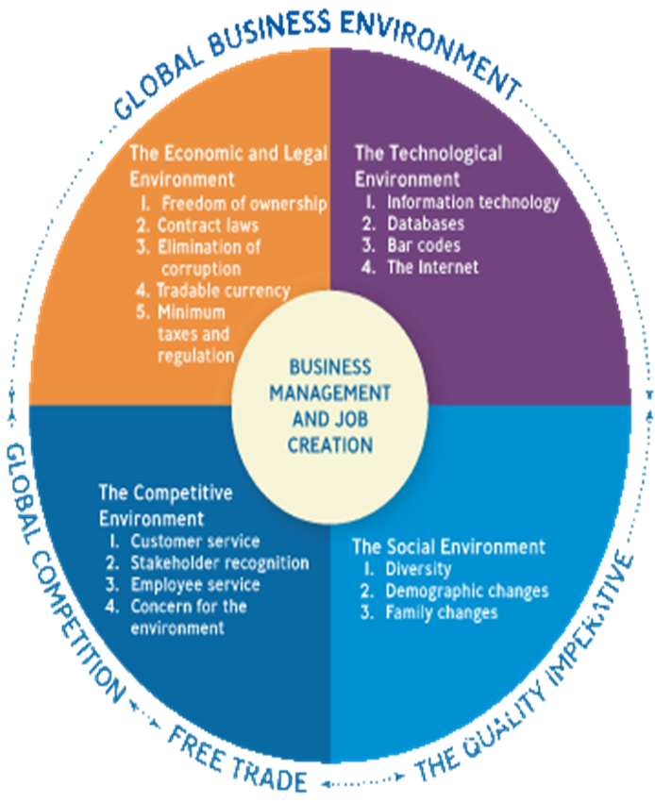
Business Environment The Business Environment is the sum total of all external and internal factors that influence a business. An external business environment is composed of all the outside factors or influences that impact the operation of business.
Introduction to Business (BUS 101). Course Instructor: Nusrat Hafiz (NHF)
*
The Business Environment
LG2
*
1-5

Slide 6
1. Economic & Legal Environment
*
Introduction to Business (BUS 101). Course Instructor: Nusrat Hafiz (NHF)
The Economic
and Legal Environment
Government actions which affects the operations of a
company or business. A government can promote business
through:
*
LG3
Minimize Spending, Tax, Strict Regulations
Encourage Private Ownership
Minimize interruptions on Free Exchange of Goods and Services
Pass Laws on enforceable business contracts
Establish currency tradable in the world markets
Minimize Corruption (“GIFTS”)
1-6

Slide 7

1. Economic & Legal Environment A video on How can we help STOP Corruption? https://youtu.be/vx2773eSbec
Introduction to Business (BUS 101). Course Instructor: Nusrat Hafiz (NHF)
*
https://youtu.be/vx2773eSbec
The Economic
and Legal Environment
*
LG3
1-7

Slide 8

Introduction to Business (BUS 101). Course Instructor: Nusrat Hafiz (NHF)
*
The Economic
and Legal Environment
Mini Activity: (1) Thumbs Up or Thumbs Down? “Govt Interference on businesses is good for new startups”
*
LG3
1-8

